Slide 1
Amazon SQS & SNS
Reliable Messaging and Notifications for Modern Applications

Slide 2

Amazon SQS (Simple Queue Service)
What is Amazon SQS?
Fully managed message queuing service.
Decouples* and scales microservices and serverless applications.
Why Use SQS?
Reliable, scalable, and cost-effective message delivery.
Handles large workloads and asynchronous communication.
*Services don’t need to directly talk to each other. One sends a message to the queue, and the other picks it up when ready

Slide 3
Key Features of SQS
Fully managed and serverless.
Two queue types: Standard (high throughput) and FIFO (strict order).
Secure with AWS KMS encryption.
Supports message retention from 1 minute to 14 days.

Slide 4
Types of Queues
Standard Queue:
High throughput.
At-least-once delivery (potential duplication).
Best-effort ordering (not strict).
FIFO Queue:
Limited throughput.
Exactly-once delivery.
Strict message order.

Slide 5
How SQS Works
Message Producers send messages to the queue.
Messages are temporarily stored in the SQS Queue.
Message Consumers poll and process the messages.
Processed messages are deleted explicitly.

Slide 6
SQS Use Cases
Decoupling microservices.
Asynchronous task execution.
Buffering for burst traffic.
Background jobs.

Slide 7
Security and Monitoring
IAM Policies: Control access to SQS.
Encryption: Server-side with AWS KMS.
Monitoring: Amazon CloudWatch for metrics like message count and age.

Slide 8

Amazon SNS (Simple Notification Service)
What is Amazon SNS?
Fully managed publish/subscribe messaging service.
Enables event-driven and real-time communication.
Why Use SNS?
High fan-out for messages.
Supports multiple protocols (HTTP, Lambda, SMS, etc.).

Slide 9
Key Features of SNS
Topic-based publish/subscribe model.
Message delivery to multiple subscribers.
Integration with SQS, Lambda, and email/SMS.
Message filtering and attributes.

Slide 10
How SNS Works
Publishers send messages to a topic.
SNS distributes the message to subscribers.
Supports multiple delivery protocols (HTTP, SQS, Lambda, SMS, etc.).

Slide 11
SNS Use Cases
Real-time event notifications.
Application alerts (e.g., system failures).
Distributing updates to multiple systems.

Slide 12
Security and Monitoring
IAM Policies: Restrict who can publish/subscribe to topics.
Encryption: Data at rest and in transit.
Monitoring: CloudWatch metrics for delivery success and failures.

Slide 13
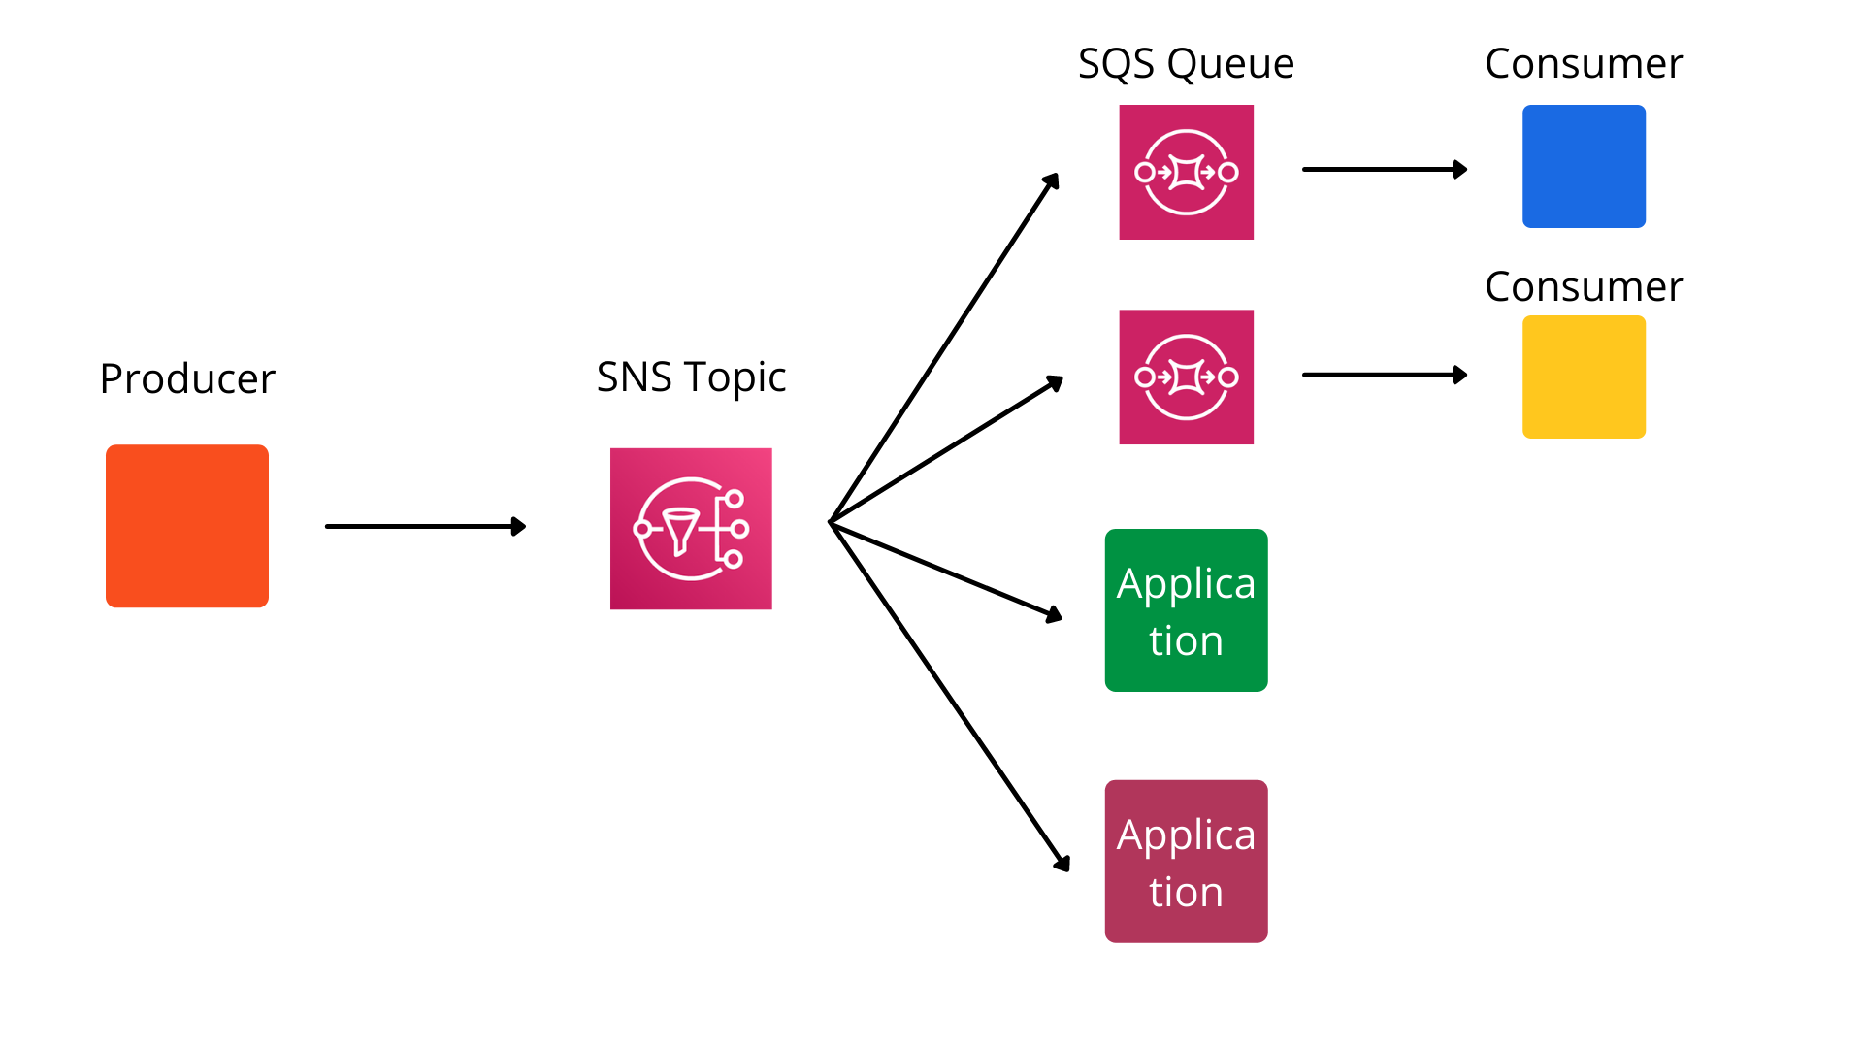
Using SQS and SNS Together
SNS can fan-out messages to multiple SQS queues.
Benefits:
Decouple publishers from consumers.
Reliable delivery with SQS buffering.

Slide 14
Practical Example
Scenario:
SNS topic publishes system updates.
Multiple SQS queues process updates for different microservices.
Advantages of Integration:
Scalable and fault-tolerant architecture.
Combines the strengths of both services (real-time and reliable messaging).

Slide 15
Summary
Amazon SQS: Reliable queuing for asynchronous messaging.
Amazon SNS: Real-time notifications with publish/subscribe.
Integration allows decoupling and scaling distributed systems.

